Slide 1
Welcome
Person Detection and Tracking
Presented By-
1)Kaushal Digraskar (36056)
2)Aniket Andharikar (36065)
Guided By- Prof.Sugandha Nandedkar

Slide 2
Marathwada Shikshan Prasarak Mandal’s
Deogiri Institute of Engineering and Management Studies,
Aurangabad
Project Presentation
On
Person Detection and Tracking
Submitted By
Aniket S. Andharikar (36065)
Kaushal V. Digraskar (36056)
Dr. Babasaheb Ambedkar Technological University
Lonere (M.S.)
Department of Computer Science and Engineering
Deogiri Institute of Engineering and Management Studies,
Aurangabad
(2019- 2020)

Slide 3
CONTENT
Introduction
Examples
SSD and Kalam filter
References

Slide 4
Introduction
1)The Project is based on Person Detection and tracking and we are mainly focusing on the Person tracking,
2)Each person will be provided with an idea as soon as he enters a frame and the number remains with his regardless of the detection happening in concurrent frames.
3)So basically the project focuses on Person Detection and track him as long as he remains in the frame.

Slide 5
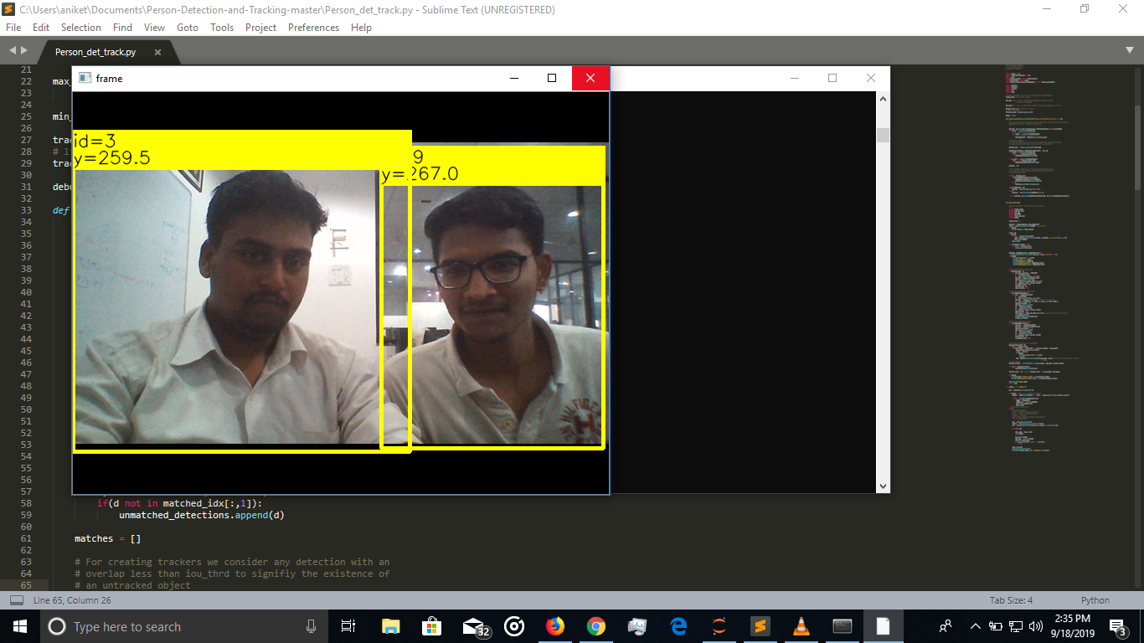
Example on person detection and tracking

Slide 6
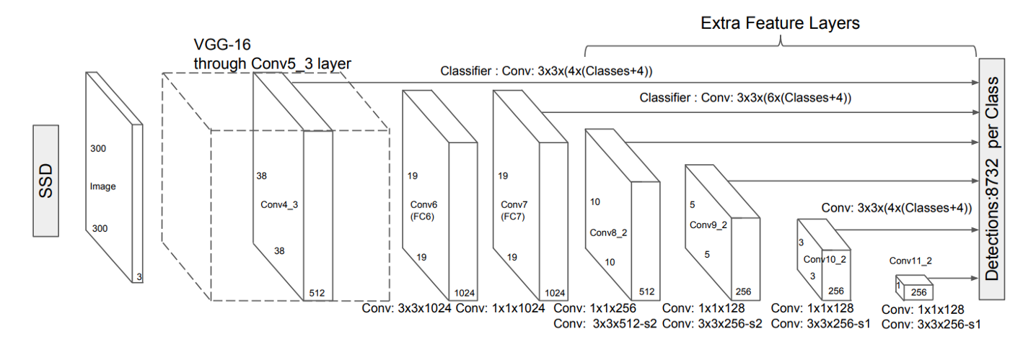
SSD (Single Shot Detection) Algorithm
1)SSD (Single Shot Detector) is a popular unified algorithm in object detection.
2)It’s generally faster than Faster RCNN

Slide 7
Kalam Filter
Kalman filtering, also known as linear quadratic estimation (LQE), is an algorithm that uses a series of measurements observed over time, containing statistical noise and other inaccuracies, and produces estimates of unknown variables that tend to be more accurate than those based on a single measurement alone, by estimating a joint probability distribution over the variables for each timeframe.

Slide 8
References
1)Wikipedia
2)https://github.com/Andharikar9011
3)https://github.com/kaushaldigraskar
4)https://github.com/ambakick/Person-Detection-and-Tracking
5) https://towardsdatascience.com/review-ssd-single-shot-detector-object-detection-851a94607d11

Slide 9
Thank You!!!!

